Slide 1


CyberShield
AI-Based Smart Network Security System
PES COLLEGE OF ENGINEERING MANDYA -571401
DEPARTMENT OF
COMPUTER SCIENCE & ENGINEERING
GUIDED BY
Dr. Prasanna Kumar R S
Associate Professor, Dept. of CS&E
TEAM MEMBERS
Adarsha J P [4PS23CS400]
Chandan K M [4PS23CS403]
Harsha Kumar D [4PS23CS405]
Rohan M K [4PS23CS413]

Slide 2
Problem Statement
Modern smart homes use multiple IoT devices that remain always connected to the internet - but users have no visibility or control over what those devices are doing.
Key Problems:
IoT devices lack built-in advanced security.
Home users can’t detect hidden anomalies or data misuse.
Existing antivirus/firewall tools focus only on PCs, not IoT devices.
Need for a unified, AI-driven home security monitor.

Slide 3
Existing System
Current Approaches:
  Host-Based Antivirus: Software installed directly on individual computers or laptops.
  Standard Router Firewalls: Basic network address translation (NAT) and static port blocking rules.
Key Limitations (The Disadvantages):
  PC-Centric Limitations: Traditional tools completely ignore headless IoT devices like smart cameras, smart TVs, and sensors.
  No Real-Time Traffic Isolation: Legacy home systems cannot automatically quarantine a single compromised device at the kernel level if an anomaly is found.
  Lack of Behavioral AI: Standard firewalls only look for known signatures and fail to catch modern, zero-day behavioral anomalies.

Slide 4
Project Objective
Goal:
  To design and develop a smart, AI-based network security system that monitors all connected IoT devices in real time, detects suspicious behaviour, and alerts users immediately.
Objectives:
  Monitor real-time network traffic of IoT devices.
  Detect unusual activity using ML-based anomaly detection.
  Provide an easy-to-use dashboard for users.
  Offer automatic isolation of infected devices.
  Create awareness and trust for secure smart living.

Slide 5
Project Requirements
Functional Requirements:
Device Discovery
Traffic Capture
Threat Detection Engine
Alert generation and Notification
Control Hub
CSV files for Logs and History
Non-Functional Requirements:
High performance (low latency)
Accuracy ≥ 90%
Scalable architecture
User-friendly interface
Reliable data storage
Easy maintenance
Portable and flexible system

Slide 6
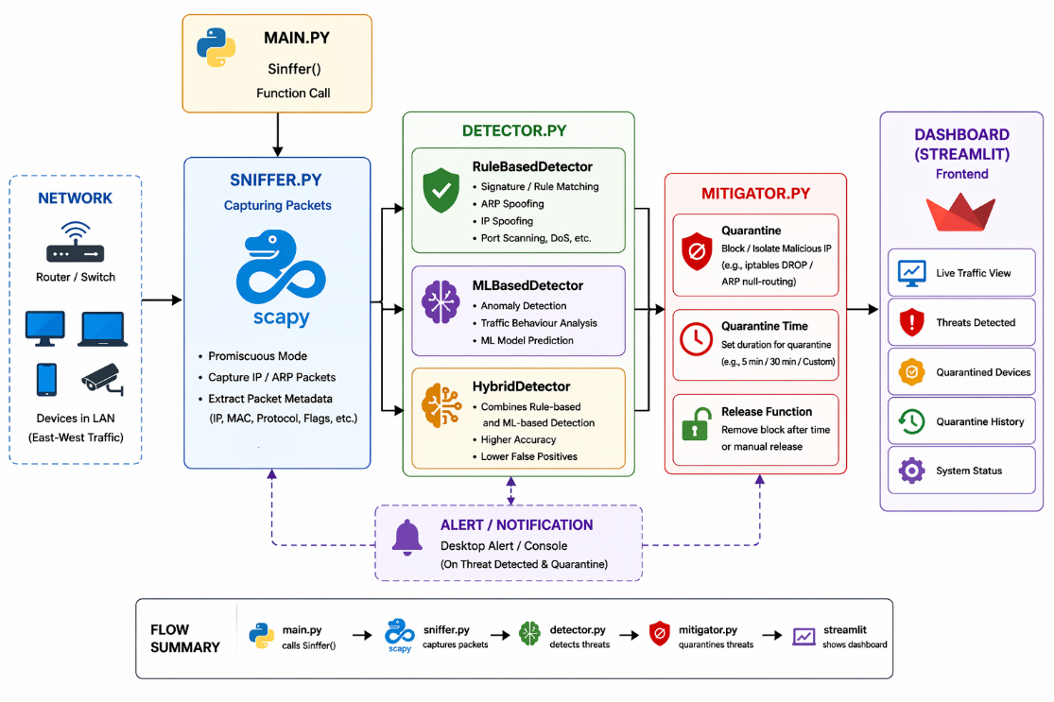
System Architecture

Slide 7
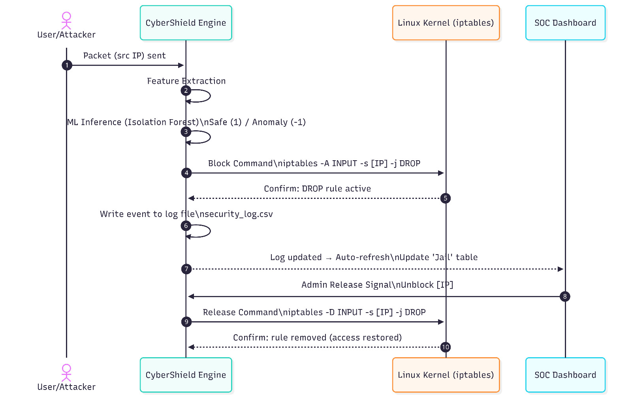
Flow Diagram

Slide 8
Modules of CyberShield
Main: Orchestrates global system data flow.
Sniffer: Intercepts real-time network packets.
Detector: Analyzes traffic for security threats.
Mitigator: Automatically isolates malicious devices.
Dashboard: Visualizes active network security status.

Slide 9
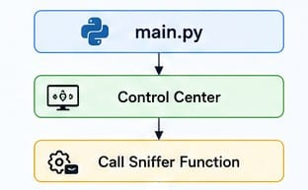
Main
Method: def main(String interface) -> int:
Function: Calls sniffer, detector, dashboard functions
Main.py and the Control Center act as the brain,
managing and organizing the entire monitoring
process.
Calls Sniffer function to captures live network data
and hands it off to other modules to scan for threats.
Return type : Integer

Slide 10
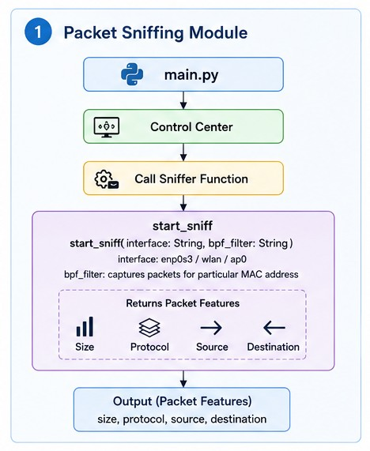
Sniffer
Method: start_sniff(String interface,bpf_filter)
Parameters: String Interface, String Array bpf_filter
Function: captures packets for particular MAC and IP address
Main.py and the Control Center launch the process and
trigger the start_sniff() function to begin monitoring.
The Sniffer grabs key details (like size and protocol) and
sends them out to be analyzed for threats.
Return type: Array – returns packet features in the array format
Return to: main() function

Slide 11
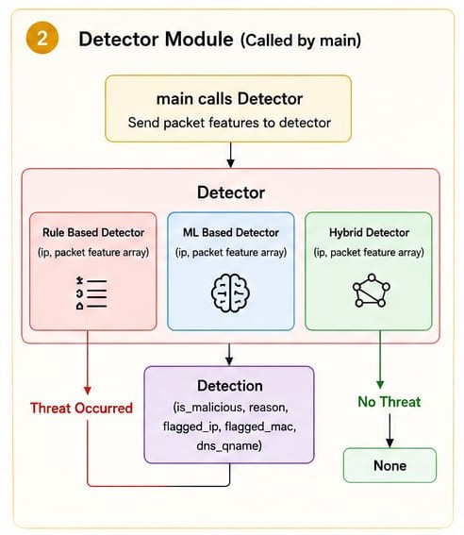
Detector
Methods: rule_based_detector(ip, packet feature array)
ml_based_detector(ip, packet feature array)
hybrid_detector(ip, packet features array)
Parameters: String IP, String Array PacketFeatures
Function:
• The Detector takes in packet data and scans it using two methods: strict predefined rules and smart machine learning patterns.
• It analyzes the traffic and provides a final report on
whether the packet is safe or malicious.
Return type: If threat Occurs: String array
else: None
Return to: if threat occurs: calls mitigator
else: main() function

Slide 12
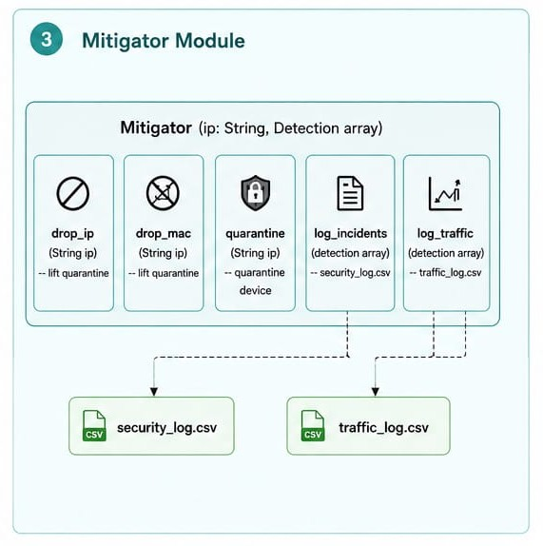
Mitigator
Methods: quarantine(String ip) -- quarantine device
    • log_incidents(detection array) -- security_log.csv
    • log_trafic(detection array) -- traffic_log.csv
• drop_ip(String IP) -- lift quarantine
• drop_mac(String MAC) -- lift quarantine
Parameters: String IP, String array Detection
Functions:
• The Mitigator stops threats by blocking suspicious addresses or quarantining dangerous devices to prevent further damage.
• All incident details and traffic data are saved into CSV log files so you can review and monitor them later.
Returns: Logs traffic to traffic_log.csv
• Logs security threats to security_log.csv

Slide 13
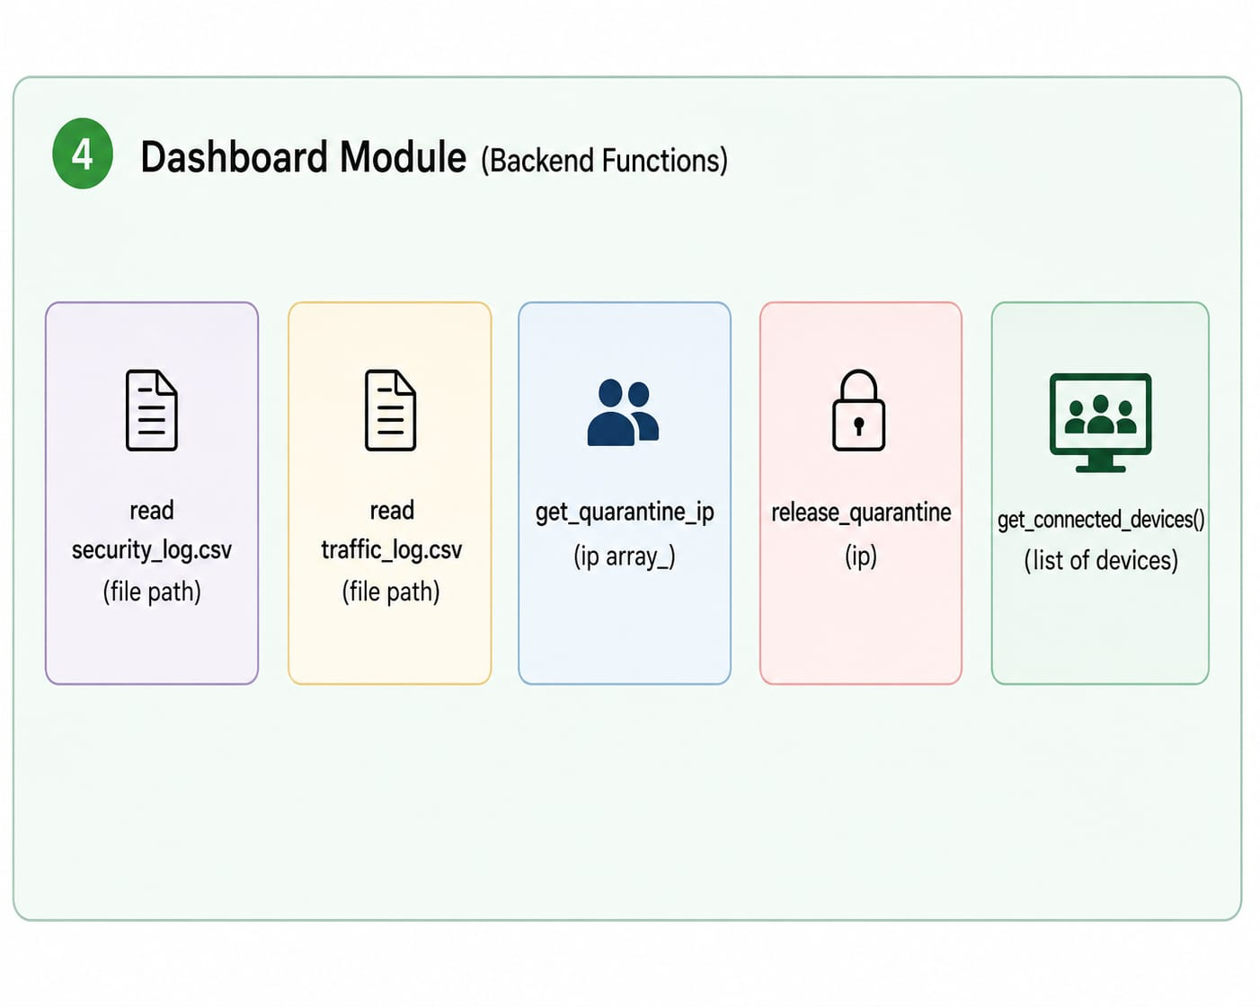
Dashboard
Methods: read security_log.csv(file path)
• read security_log.csv(file path)
• get_connected_devices()
• get_quarantine_ip(ip array)
• release_quarantine(ip)
Parameters: String IP array and File Path
Functions:
  • The Dashboard pulls data from the security and traffic logs to show the admin exactly what is happening on the network.
• It displays all quarantined devices and gives admins the power to easily unblock or release them when needed.

Slide 14
Unit & Integration Testing
Category | Scenario | Pass Criteria | Fail Criteria
Unit | Packet Parsing (Sniffer) | Correctly identifies IP and Protocol headers. | Crashes on raw stream or misidentifies protocol.
Unit | Threshold Logic (Detector) | Detection triggers True if threshold > 50. | Ignores high volume or returns False during surge.
Integration | Data Pipeline Flow | Detector receives valid object from Sniffer. | Data lost in queue or format becomes incompatible.
Integration | Alert Sync | Dashboard UI updates instantly upon detection. | Threat is identified but UI shows "System Clear".

Slide 15
Functional & Performance Testing
Category | Scenario | Pass Criteria | Fail Criteria
Functional | Auto-Mitigation Action | IP blocked automatically via iptables kernel rule. | Command executed but device still sends traffic.
Functional | Sniffing Start Control | Main.py initializes sniffer on correct interface ID. | Sniffer fails to bind or button is unresponsive.
Performance | High Traffic Load | Responsive at 1000 packets/min or more; no leaks. | Program crashes, lags, or skips packet analysis.
Security | False Positive Guard | Large safe downloads recognized as legitimate. | Mitigator accidentally blocks the safe user.

Slide 16
Conclusion
The CyberShield project successfully demonstrates a modular approach to network security by integrating real-time traffic sniffing, intelligent threat detection, and automated mitigation.
By bridging the gap between raw network data and a user-friendly dashboard, the system provides a comprehensive defense mechanism against common network-based attacks like DDoS and unauthorized scanning.
Key Achievements:
Real-time Responsiveness: Achieved seamless data flow from Sniffer to Mitigator.
Automation: Reduced human intervention time by automating IP blocking.
Visibility: Provided a clear graphical interface for monitoring network health.

Slide 17



Achieved SDG Goals
SDG 9:Industry, Innovation and Infrastructure
SDG 11: Sustainable Cities and Communication
SDG 16: Peace, Justice and Strong Institutions

Slide 18
Future Enhancement
Machine Learning: Integrating AI to detect "Zero-Day" attacks based on behaviour rather than just thresholds.
Cloud Integration: Expanding the Sniffer to monitor virtualized cloud environments.
Deep Packet Inspection (DPI): Looking deeper into encrypted payloads for hidden malware.
Router Integration: Providing security to the LAN networks

Slide 19
References
1. Chatterjee, A., & Ahmed, B. S. (2022). IoT anomaly detection methods and applications: A survey. arXiv preprint arXiv:2207.09092.
🔗 https://arxiv.org/pdf/2207.09092
2. Data & Metadata. (2022). Anomaly detection in network traffic using machine learning for early threat detection.
🔗 https://www.researchgate.net/publication/373443452
3. Zhou, H., Liu, Q., & Wang, L. (2023). Anomaly detection in IoT and sensor networks: A survey. Sensors, 23(4).
🔗 https://pmc.ncbi.nlm.nih.gov/articles/PMC9920825
4. Sabit, H. (2025). Artificial intelligence–based smart security system using Internet of Things for smart home applications. Electronics, 14(3), 608.
🔗 https://www.mdpi.com/2079-9292/14/3/608
5. Thakur, P. (2024). Edge AI enabled IoT framework for secure smart home infrastructure. Procedia Computer Science, 231, 1047–1054.
🔗 https://www.sciencedirect.com/science/article/pii/S1877050924009979
6. Github Repository Link
🔗 https://github.com/hkdprojects/CyberShield-Smart-Network-Security-System

Slide 20
Thank
You

